Slide 1
<insert date of presentation>
Why Partner with The Cerrado Group
Presented by:
<insert name, title, and affiliated company name of TCG>
Ann Slotwinski Executive Director The Cerrado Group
Notes:
This is the opening slide. Display this slide for the start of the presentation.
Reference [date]. Today is… [date]
Introductions – The host and/or moderator can/should introduce the Presenter on this slide

Slide 2
Agenda for Today
Talking points and learning objectives
1
2
How We Can Help You
3
Hot Topics – Ideas, Concepts, Solutions
The Cerrado Group
Notes:
This slide is the Agenda. It outlines talking points and learning objectives covered in this presentation.
The Cerrado Group –What is The Cerrado Group, and Why TCG was formed
How We Can Help Support You – [emphasis ]
How We Can Help to Support You
Hot Topics—Ideas, Concepts, Solutions – [emphasis]

Slide 3
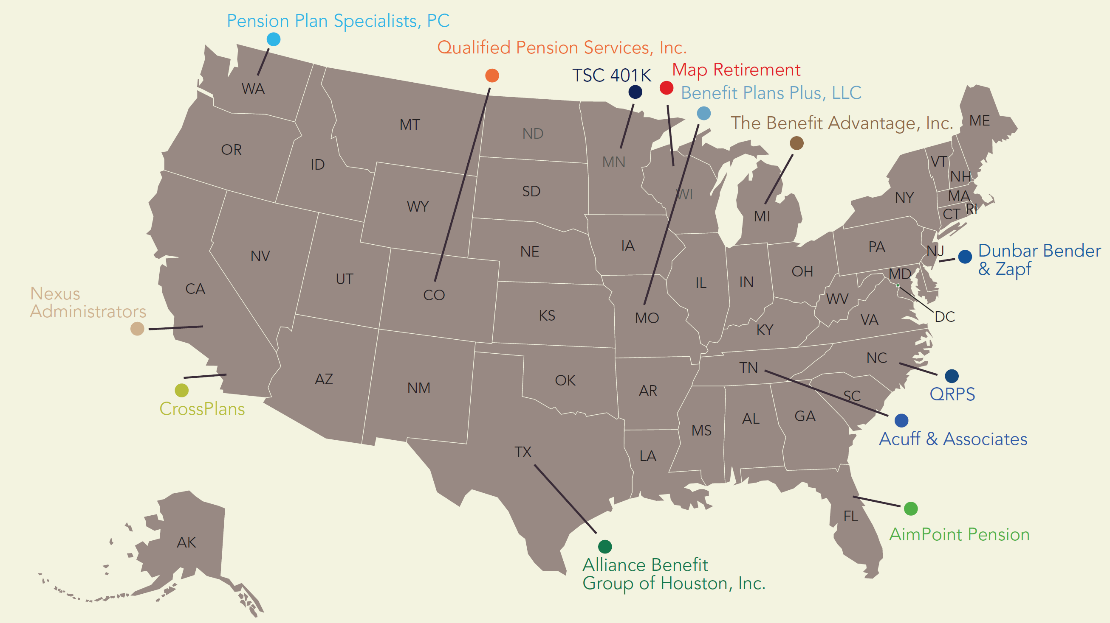
14 Member Firms With 199+ Credentialed Employees 23,000+ Plans Managed With An Average Retention of 8 Years
More Than $43.5 Billion+ In Total Plan Assets Under Administration 755,000+Retirement Plan Participants
Our Uncommon Diversity Propels Our Uncommon Strength
Notes:
This slide (at the top) shows metrics of member firm.
The Cerrado Group map shows geographic coverage of member firms dispersed across the United States
We formed in 2021 to create a collective to compete effectively against the national firms, by offering the same broad geographic coverage and services, without having to sell our firms
This slide (at the top) shows metrics of member firm.
Our collective also allows us to share best practices with the best TPAs in the industry
We are forward thinking and tech savvy
We are constantly looking for ways to create efficiencies and expand our distribution
We are Cyber Ready! All members have Cyber Insurance, all are being assessed against The Cerrado Standard- our customized Cyber Policies and Procedures

Slide 4
The Cerrado Group – Member Services
Retirement Plan Types Served
DC - 401(k) / Profit Sharing
DB & Cash Balance Plans
ERISA & non-ERISA 403(b)
Governmental & Non-profit 401(a) & 457(b)
457(f) Plans
ESOP Administration
Standard Services
Interpret plan documents
Contribution calculations
Compliance testing & regulatory filings
Consulting Services
Custom Plan Design
Technical Corrections
Governance & Compliance
IRS/DOL Audit Representation
Merger & Acquisition Plan Reviews
Benchmarking
Daily Valuation Recordkeeping
Actuarial Services & 3(16) Fiduciary Services
* All items listed are an example of offerings from different firms. Each firm will have its own distinct list of services offered and those offerings will vary.
Notes:
Bullet points on this slide can be read exactly as they appear

Slide 5
We fix broken retirement plans
Increased closing rates
Unparalleled Product Provider intelligence
How We Can Help Support You
Day-to-day single point of contact
Geographic coverage with interchangeable service models
Custom plan designs – large & small, tax advantaged
Notes:
How we can help
Value proposition
Fix broken retirement plans- we are the best in the Industry
Increase close rates- data shows that if the TPA is present during the finals presentation, the close ratio increases,
Localize Product Provider intelligence – we have at least 1 member on each major Product Provider’s Advisory Boards. W can tell you who offers what and who is good at what
Day to day single point of contact
National coverage offering all services collectively
Custom plan design for all tax advantaged plans

Slide 6
Ideas – Concepts – Solutions
Things to Think About to Fuel the Selling Season
ROTH 401K
The Power of the Right Plan
Hidden Advantages
Secure 2.0 Updates
Solo K - Mega Roth
Questions to Ask
SIMPLE vs. 401(k)
Profit Sharing
Cash Balance
Questions to Ask
Recent Legislative Changes
Changes to drive Employer and Employee Engagement.
Where the opportunity exists.
Questions to Ask
Notes:
Summary slide for next several slides – topics that will be discussed

Slide 7
Roth 401(k) : Hidden Advantages
This is the time of year to provide the solutions businesses are looking for due to enhance their plan.
No income limitations like Roth IRA
Roth 401(k) Required Minimum Distribution (RMD)
Employer Contributions Treated As Roth
In-Plan Conversions and Transfers
After Tax Contributions: Mega Roth
Notes:
Business owners are looking for solutions that allow them to take full advantage of the tax benefits of a qualified plan, but are often limited.
Roth 401(K) allows for $22,500 in deferrals in 2023 with a participant over the age of 50 reaching $30,000 with catch-up of $7,500. Level of income does not matter.

Slide 8
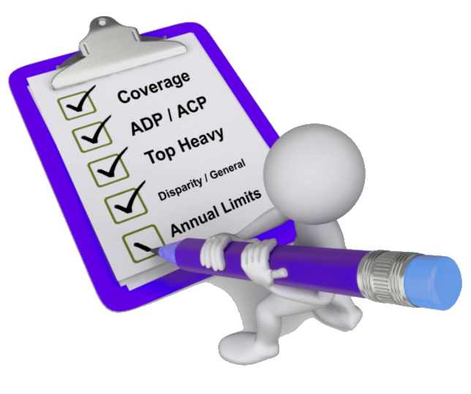
Roth 401(k) Secure Act 2.0 Updates
Employer Contributions as Roth
Optional provisions starting in 2023
Roth 401(k) RMD
Effective for tax years beginning after December 31, 2023.
No pre-death RMD is required for Roth 401(k) accounts.
Participants choose to treat their matching or non-elective contributions as Roth
Contribution is still deductible by Employer
Tax paid by Participant
Does not apply to first year eligible 2023 RMD due by April 1, 2024.
Catch-up Roth deferral
Starting in 2024, employees with $145,000 (annually indexed) or more in compensation in the prior tax year must take the age 50 or older catch-up deferral as an after-tax Roth contribution.
Notes:
Roth employer contribution changes provide an enhanced opportunity for all participants to allow greater after-tax on principal and earnings.
A participant can in theory have their entire contribution for the year, employee and employer go in as Roth.
Waiting on guidance from the IRS and DOL for procedures on how to make elections on the contribution side and the tax end.
Major recordkeepers in a similar position of updating systems to accommodate updates.
Built up Roth 401(k) and Roth Employer balances are no longer subject to RMD requirements.
In the past, Roth 401(k) balances required an RMD to be taken. This was a significant impact to owners of businesses.
Partial withdrawals restrictions also prevented a removal of Roth 401(k) balances to a Roth IRA to avoid RMDs.
Simplification of rules and prior confusion on 5 year clock in both 401(k) and Roth IRAs.
Long term potential distribution tax benefits for inherited IRAs.

Slide 9
SOLO-K: Mega-Roth
Business Owner Age 61 with $500K Income
Goal to reach $73,500 maximum 415 Limits
401(k) Three Bucket Approach:
1. Roth 401(k) Deferrals
2. Employer Contributions
3. Voluntary After-Tax Contributions
Notes:
**Disclaimer regarding the risk of doing this before more guidance is available.
Let’s look at an example scenario for a solo 401(k) to make your Roth 401(k) dollars fly.
Goal to reach maximum of $73,500. Three key factors on which buckets to use.
1. Overall income level: Income below approximately $175K will need to use Voluntary After Tax because of 25% deduction limit to reach goals.
2. Tax Tolerance in current year: Using multiple buckets to regulate level of tax to be paid. The ability to use in-plan Roth transfers on a flexible basis to drive Roth tax advantages.
3. Entity Type: S-Corp W-2 payments for each income vs. self employed individual. W-2 becomes very critical for S-Corp LLCs.
Secure Act changes with employer contributions treated as Roth may help to lessen the need for voluntary after-tax bucket. Also avoids the needs for in plan conversions or transfers.

Slide 10
SOLO-K Mega-Roth In action
-
Scenario 1
$30K Roth 401(k) or Pre-Tax Deferral
$43,500 voluntary after-tax contribution
Scenario 2
$30K Roth 401(k) or Pre-Tax Deferral
$25K Employer Profit Sharing
$18,500 voluntary after-tax
Can design any combination of employer vs. after-tax.
Use In-Plan Conversions for flexibility
Notes:
Two scenarios possible out of a number of options
Great way to turn a smaller additional income into substantial savings annually
Take note to consider only one personal 401(K)/Roth deferral maximum amount available over multiple plans.
Conversions and transfers can be used at any age if properly designed in plan document. Not only reserved for 59.5 or older distributions any longer.

Slide 11
Questions To Ask Your Clients
Roth 401 (k)
Are you aware of the various personal and financial advantages provided in accumulating retirement assets post tax?
In your current 401k Plan, are employees allowed to elect ROTH salary deferral contributions.
In your current 401k Plan, do employees have the ability for in plan ROTH conversions and transfers.
Are you aware of changes that have recently been passed regarding higher paid employees treatment of catch-up deferrals and how they may impact your plan?
Would you like to set up an appointment to allow me to show you the opportunity to go over these changes and show you how to implement them in your plan?
Notes:
These are the questions you should ask your clients/prospects to ascertain what they have or what they know about this plan feature.

Slide 12
Business Owners are looking for solutions to key questions;
How do I reduce my personal/corporate tax liability?
How do I increase my personal net worth?
How do I attract/retain key employees?
How do I create a meaningful employee benefit that is cost effective, minimally burdensome and with very little personal liability?
Having the right retirement plan in place can be the strategic solution that addresses all of these questions!
The Power of the Right Plan
Notes:
Review items on the slide.

Slide 13
SIMPLE vs. 401(k) Profit Sharing Plans
Notes:
Review why a 401k may make more sense than a SIMPLE.

Slide 14
Is the Juice Worth the Squeeze?
Notes:
Many CPA’s and Financial Advisors gravitate to a SIMPLE plan because they are well, simple. However, is the simplicity what’s most important to the client, or is the ability to use a retirement plan to reduce personal tax liability, reduce corporate tax liability, and increase personal net worth what the client is really asking for?
Frequently, CPA’s will tell us they didn’t realize the potential the right plan would have had if it was implemented sooner. They chose to take the easy route. So, is it worth it to explore the options beyond those that are simple and perhaps cheaper to administer in order to find the RIGHT solution?

Slide 15
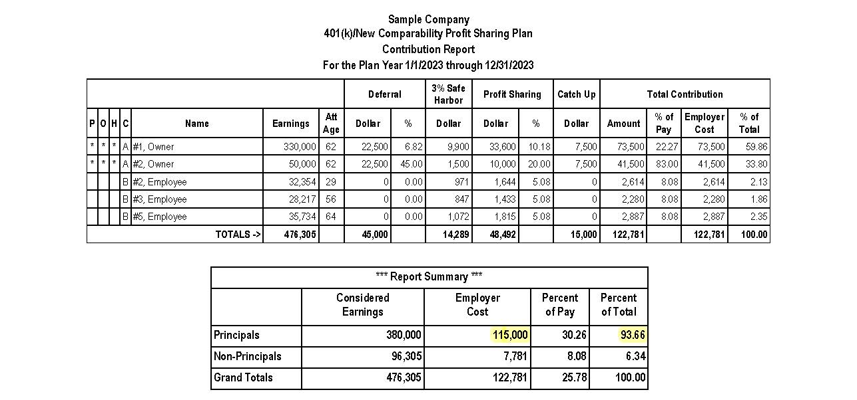
Notes:
There are several methods to make Profit Sharing Contributions. One of the more effective methods is called “Cross-Testing” or “New Comparability”.
What’s important to understand here is:
The amount of deferral an HCE can make to a 401(k) when the plan is designed properly is significant compared to other plans. This is outlined in the read box.
Regardless of the participation of the NHCE, the HCE can still make the maximum contribution by taking advantage of the Safe Harbor provision. This is outlined in Yellow.
Overall, the total amount of the deductible contribution is impressive, but even more impressive nearly 93% of the total contribution is being made to the owners.
This design accomplishes the goal of providing the tax deductibility owners and HCE’s are looking for, while efficiently increasing their net worth. Additionally, there is the advantage of this being a qualified trust, so it is protected from creditors.
This is one of the most popular plan designs the drives opportunity. However, there is one additional plan option that can be added for those who maybe got a late start on saving for retirement, or are in need of a greater deduction than this. Its called a Cash Balance Plan.

Slide 16
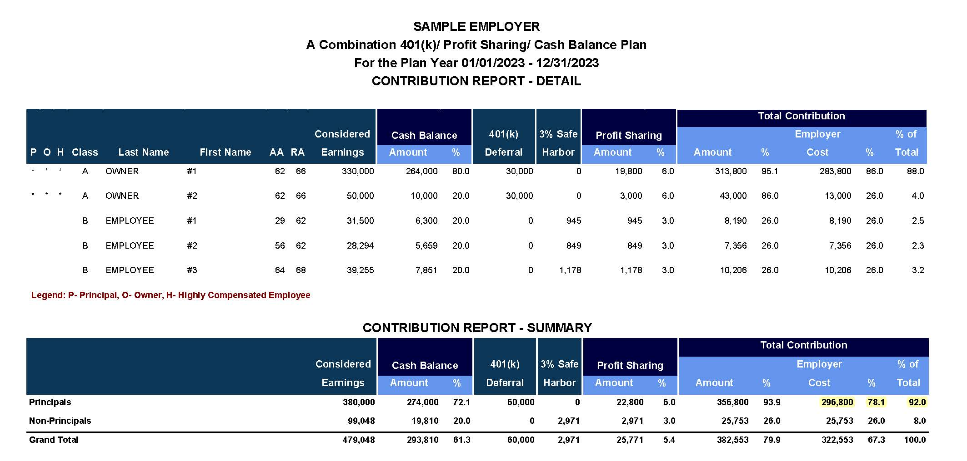
Notes:
Even though Cash Balance plans can be complicated and require an Enrolled Actuary, they can be a terrific solution for the right candidate. Don’t worry about understanding the details, that’s why you have us. What’s important to understand is the general concept that CB plans when paired with a properly designed Defined Contribution plan, like a 401(k) Safe Harbor plan with a Cross-Tested P/S contribution, can provide an ER with a significant tax-deductible contribution.
Even though the HCE’s are receiving the overwhelming majority of the contribution, not all company’s can say they provide a generous contribution to their EE’s to help them succeed in retirement. In this example most of the EE’s are receiving a 9.18% contribution.
Again, it’s not important for you to be the expert in CB plans. It far more important you learn to identify opportunities you can work with your TPA partner on to bring solutions like this.
Candidates for these plans typically:
Have consistent cash flow
Are high earners
Typically, less than 100 EE’s, but this is not always the case. We have many plans that are larger, but those are not your typical candidate.
Are looking for a larger tax deduction than can be found with a Defined Contribution plan
Have a need to save a significant amount of money due to a short time horizon before retirement
Committed to having a plan in place for at least 3-5 years
Willing to contribute to their EE’s

Slide 17
Questions To Ask
The Power of the Right Plan
Would you like to set up an appointment where I can introduce you to a plan design that would allow you to contribute the same amount of company contributions you are currently contributing, or less, and allow your highly compensated individuals to have more money contributed on their behalf and not be deemed to be discriminatory?
Are you aware of changes that have recently been passed and how they may benefit your plan?
Would you like to set up an appointment to allow me to show you the opportunity to go over these changes and show you how to implement them in your plan?
Notes:
**Redo slide.
Are you interested in how the optimum plan design:
May assist in reducing your personal tax liability?
May assist in reducing your corporate tax liability?
May assist in increasing your personal net worth?

Slide 18
Other Recent Legislative Changes
Tools to Think About to Fuel the Selling Season
START UP & CONTRIBUTION TAX CREDIT - Increases the tax credit to 100% of an employer’s out-of-pocket costs of starting up a plan, to a maximum credit of $5,000 per year for 3 years for employers with 50 or fewer employees. Employers that establish a plan will get a tax credit for contributions for employees whose wages do not exceed $100,000. The maximum credit per employee is $1,000 and the credit is available for the first five years the plan exists (2023).
EASY ‘SIMPLE’ TO 401K - Employers allowed to replace SIMPLE retirement accounts with Safe Harbor 401k plans during a year (2024).
NEW PLAN AUTO ENROLLMENT - requires 401(k) and 403(b) plans established after the date of Secure 2.0 enactment to automatically employees in the respective plans when they become eligible (and allows employees to opt out of coverage). The initial automatic enrollment amount must be at least 3% but not more than 10%. Each year thereafter that amount is increased by 1% until it reaches at least 10% but not more than 15%. (2025).
Notes:
Recent Federal and state legislative actions are trying to address the ‘pension income gap’ experienced by many Americans in having insufficient accumulated retirement assets to provide income at retirement. Legislative changes are earmarked to employers and employees to encourage participation and make it easier/less burdensome for employers to start and establish Plans.

Slide 19
Legislative Changes: Where the Opportunities Exists
Auto Enrollment: 62% of 401k Plans use (2020) with 92% of employees still participating after 3 years enrolled (compared to 29% with voluntary enrollment).
Saver’s Tax Credit: depending on income, max credit $1,000 ($2,000 filing married, joint) when contributing up to $2,000 ($4,000 filing married, joint) to qualified Plan. Decreasing credit % as AGI increases.
State Run Mandated Retirement Programs: California, Oregon, Colorado, Connecticut, Illinois, Massachusetts, Washington, Maine, Maryland, New Jersey, New Mexico, Virginia, Vermont, New York
Federal Tax Credit for New Plan Startup and Contribution Costs: available to employers with under 50 employees and for the first 3 years of the Plan.
Notes:
Auto enrollment – becoming more employer accepted – results from ADP and Vanguard. $500 credit for auto enrollment.
Saver’s Credit – 50% of contribution below $41K married joint AGI ($20.5K single); 20% of contribution between $41K-$44K joint AGI ($20.5K-$22K single); 10% of contribution between joint AGI $44k-68K ($22K-$34K single)
State programs- most are payroll deduction ROTH IRAs, more states considering, many employers reluctant & not aware of alternatives

Slide 20
Questions To Ask
Legislative Changes: Where the Opportunities Exist
Are you getting the level of employee engagement you’d like?
Have you considered utilizing auto enrollment features into your Plan?
Are employees who meet certain income levels aware of the powerful Federal “Savers” Credit?
If you’re in a state with a mandated state run retirement program, have you explored the advantages of an employer sponsored retirement Plan?
Would you prefer to control the retirement offering to you and your employees by supporting an employer sponsored Plan, over the state run program?
Would you like to set an appointment to discuss how a new employer sponsored Plan and the resultant administrative costs can be dramatically reduced with the new Federal Plan implementation and supporting tax credits?

Slide 21
“ The best time to plant a tree was 20 years ago. The second best time is now.”
— Chinese Proverb
Notes:
Regardless of where you are in your practice, it’s never too late to incorporate retirement plans into it. There are so many solutions you can provide to your relationships that can be easier for more experienced Financial Advisors to introduce, while other solutions exist that can be instrumental in jump starting you to the next level, like the those we discussed today. One of the easiest ways to get started is to always remember to, “Mention the Pension” so everyone knows to look to you when it comes to retirement plans.
We just went through a lot of information. Don’t hesitate to call me if you have questions or plans you’d like me to look at.

Slide 22
Together We’re Better—Let’s Talk!
Ann Slotwinski
Executive Director
The Cerrado Group
aslotwinski@cerradogroup.com
808-209-0301
Visit us at: www.cerradogroup.org
Our Uncommon Diversity Propels Our Uncommon Strength
Notes:
Talk to your Cerrado Group member TPA firm with any questions on the topics covered in this presentation or any other questions you may have.

Slide 23
www.cerradogroup.org

